Slide 1

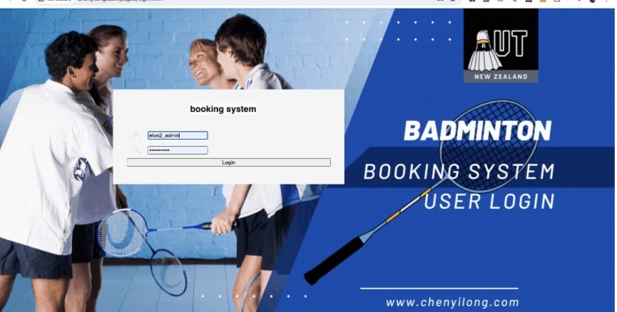
Badminton Booking
By: Yilong Chen, Ryan Lafferty, Zee Zakiya, Serena Wang

Slide 2
Outline
Project Description
User Actions
Technologies and Resources
Application Architecture
Frontend and Backend Design
Demo
Future Works

Slide 3

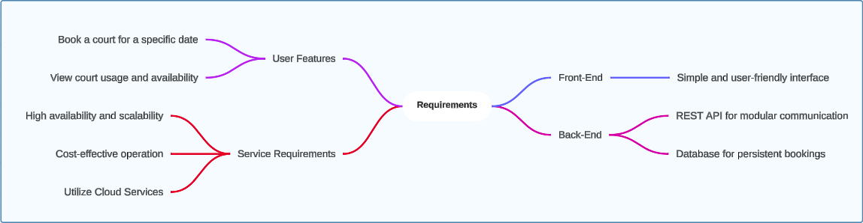
Project Description

Slide 4
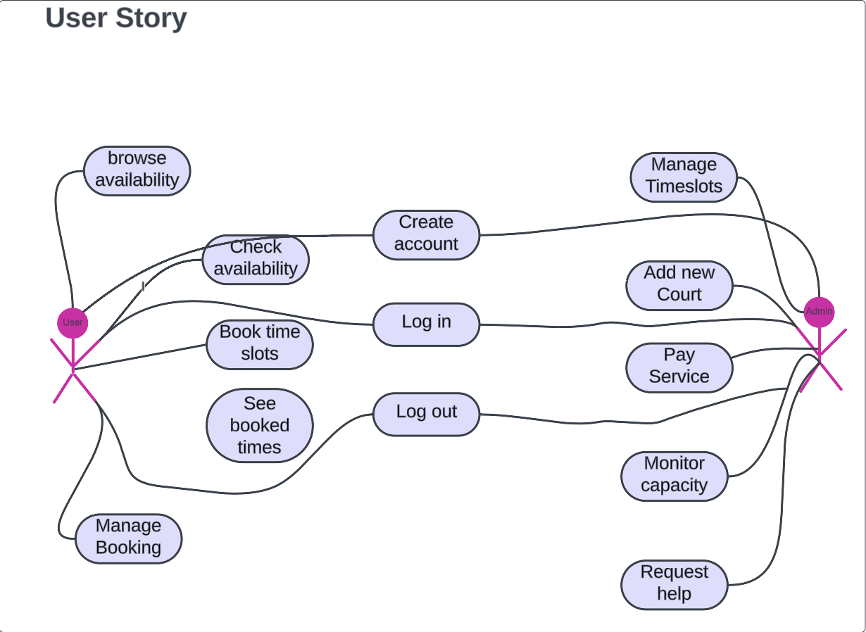
User Actions
Utilized User Story diagrams to define and document the initial application requirements
Facilitated a clear understanding of user needs and system functionality
Provided a foundation for further detailed specifications and development planning
Notes:
Breifly discuss the user actions in the diagram between the user and admin.

Slide 5
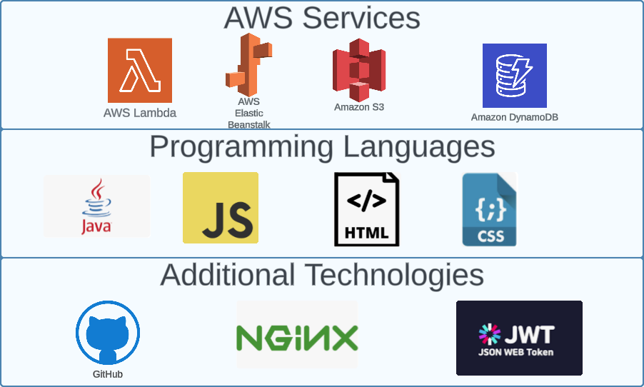
Technologies and Resources
AWS Service to deploy the Application
Backend Development: Java
Frontend Development: ReactJS, HTML, CSS
Authentication: JWT (JSON Web Tokens)
Load Balancing: NGINX
CI/CD: GitHub
Notes:
Utilized Elastic Beanstalk for seamless deployment
Leveraged DynamoDB for efficient semi-structured JSON data handling
S3 to store files and images

Slide 6
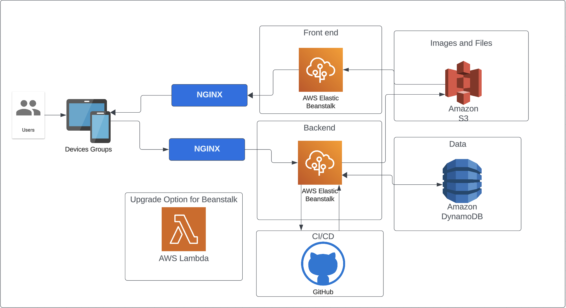
Application Architecture

Slide 7

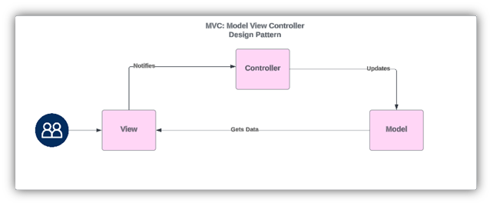
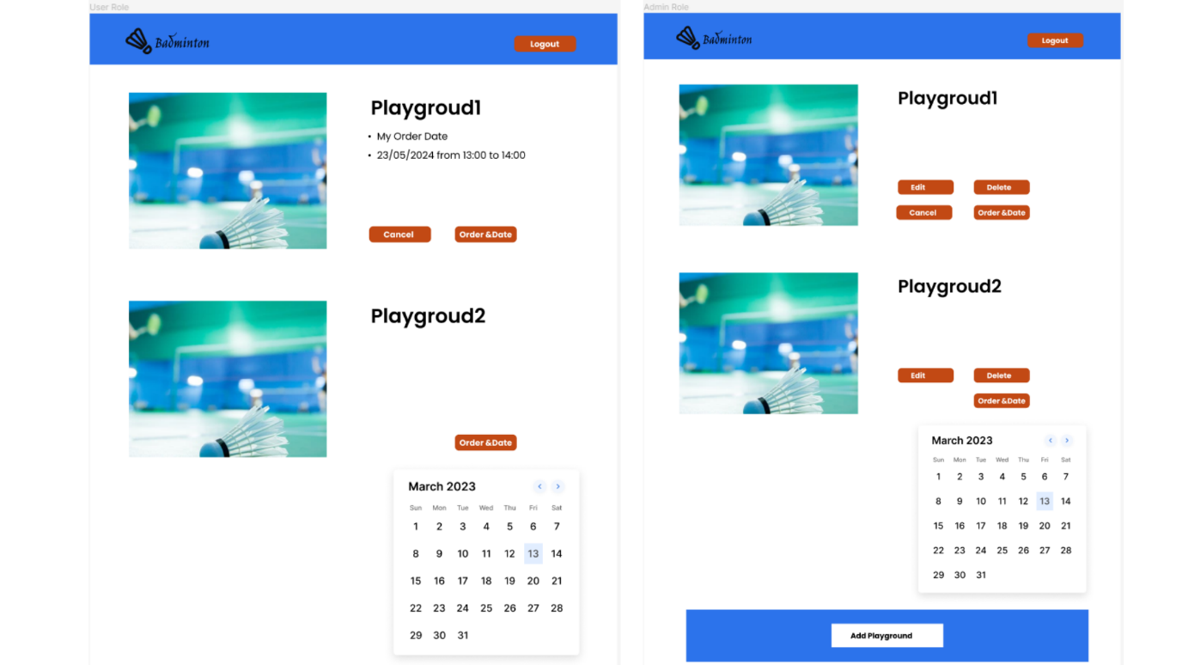
Front and Backend Application Design
The frontend developed using Figma for creating detailed and interactive UI/UX designs
The backend implements a Model-View-Controller (MVC) design pattern to separate concerns and enhance maintainability

Slide 8
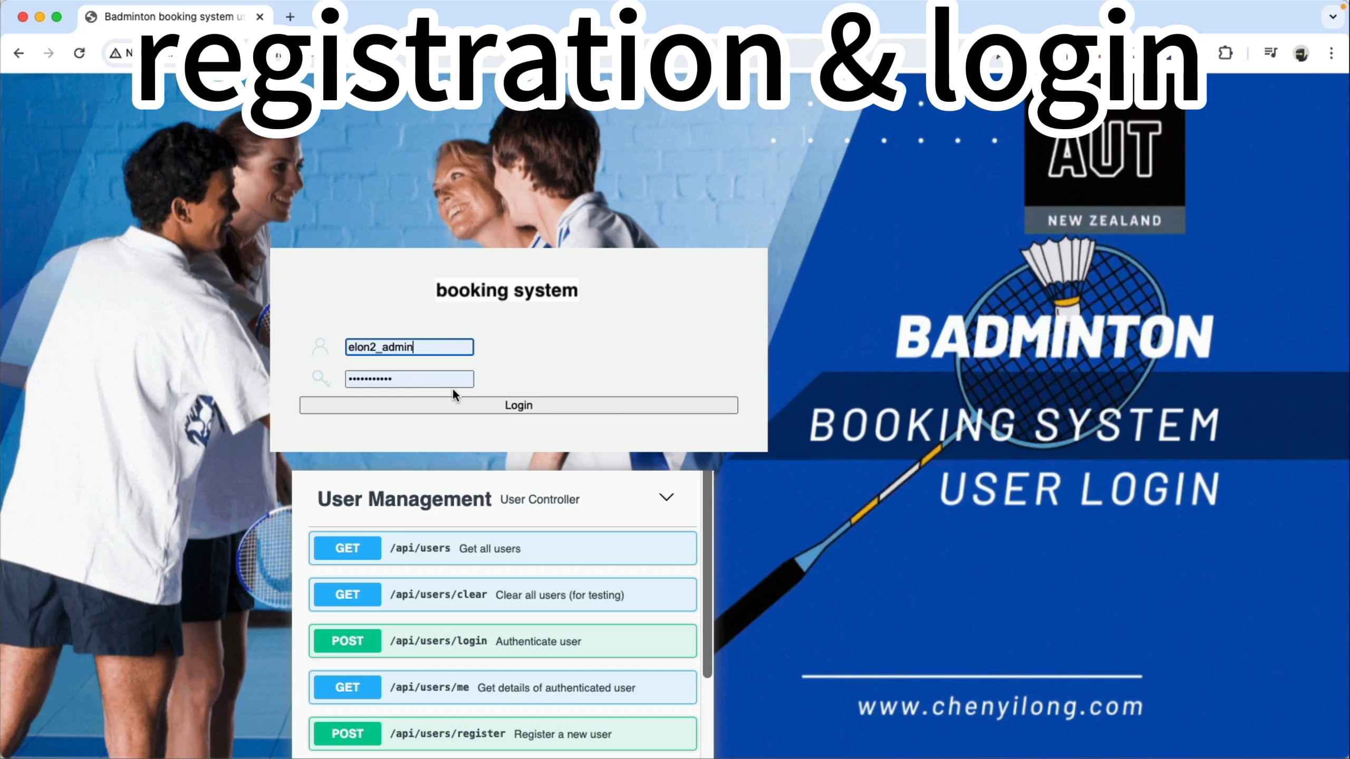
DEMO

Slide 9







Future Works
Add Data Warehouse and ETL from DynamoDB to Snowflake/ Redshift
Add a payment system (eg. Windcave)
Multifactor Authentication (MFA)
Adding functionality for different types of courts and event locations
AWS Lambda for backend application
CloudFront implementation for CDN and frontend application

Slide 10
Thank You

